Slide 1
Introduction to Argument Analysis
Part 5: Art as Argument, Visual Rhetoric, and OPTIC

Slide 2
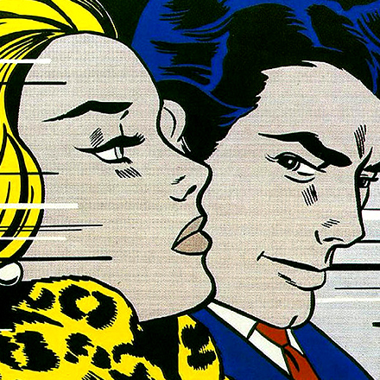
Goals!
We’ve treated obvious arguments as arguments… but what about texts and images that are performative, artistic, or ambiguous? How can we understand them as arguments?
We’ll look at the last kind of argument--artistic--today.

Slide 3
But First… What even IS art?
As in, what would you
consider to be ‘art’?

Slide 4
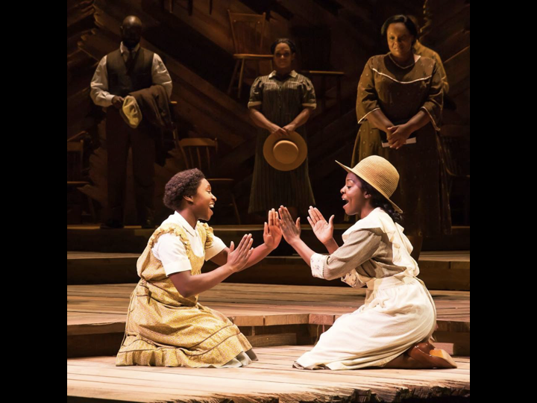
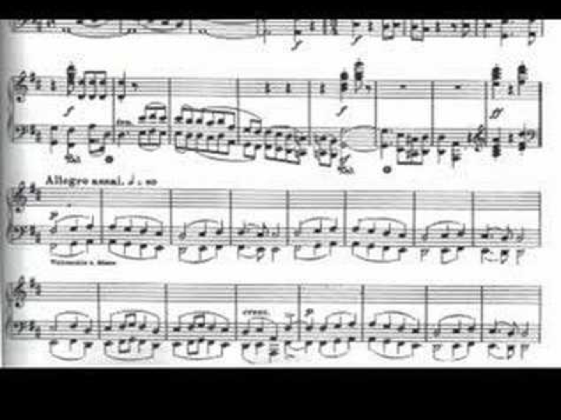
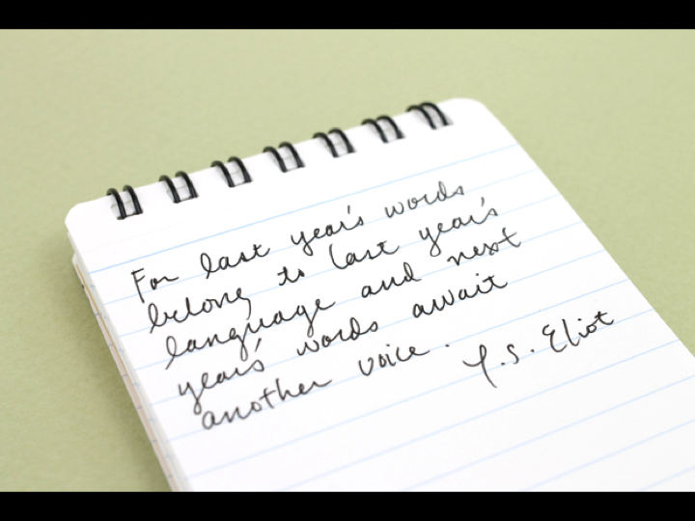
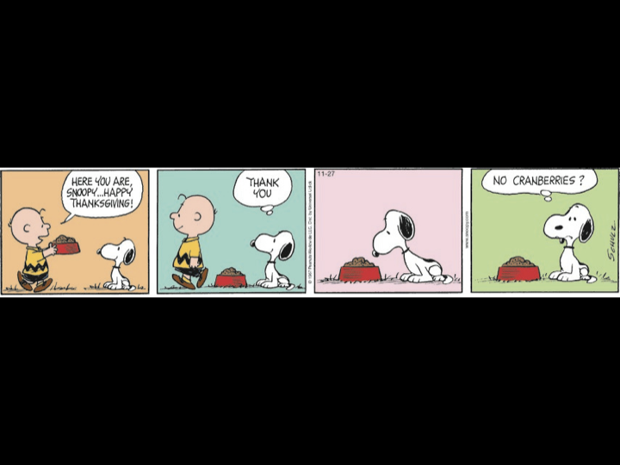
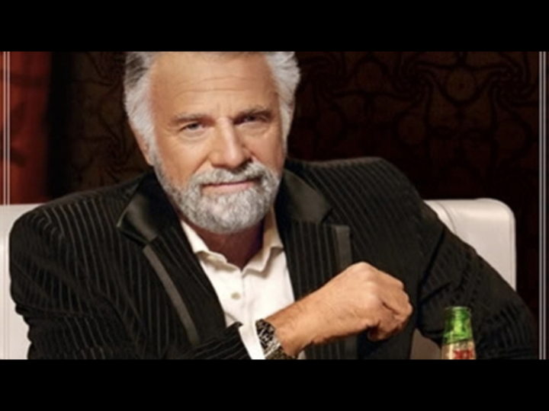
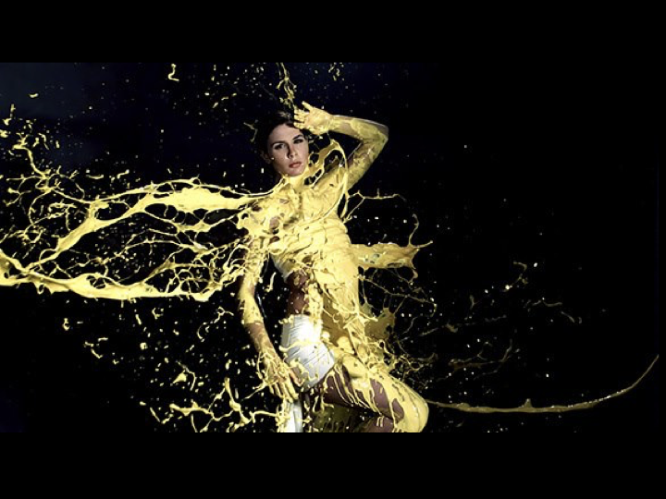
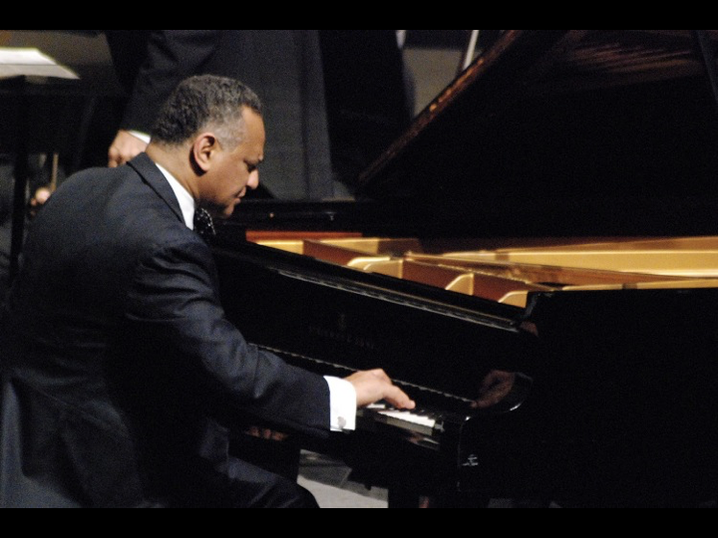
4

Slide 5
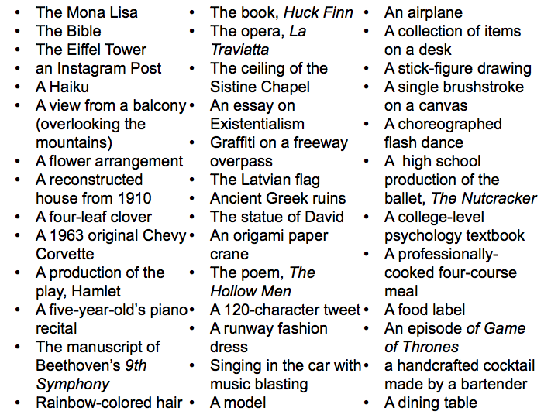
Art List
5

Slide 6
Defining
“ART”
Brancusi’s “Bird in Space”

Slide 7
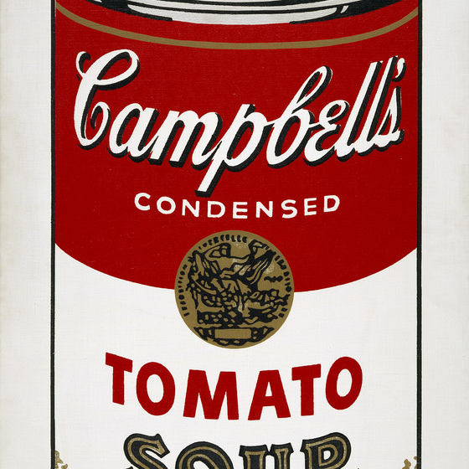
POP ART: The Original Challenger
Pop Art: A major art movement from the mid 1950’s in England and by the early 1960’s was at its fullest potential in New York.
Themes and techniques were drawn from popular culture (hence “pop” art).
Pop art aims to target a large audience, but is often academic and difficult for some people to understand.

Slide 8
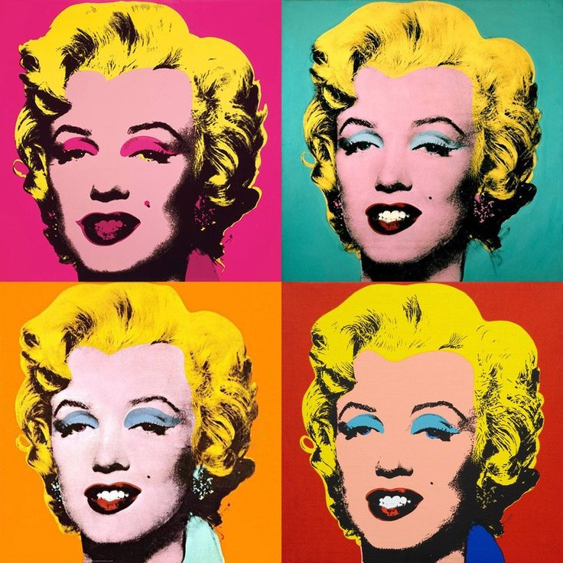
Andy Warhol (1928-1987)
one of the most influential American artists of the 20th century
drew on images such as comic books, soup cans, movie stars and the media to challenge the "highbrow" views of fine art
In addition to being an artist, was a filmmaker, painter, collector, music producer, commercial designer and illustrator, author, magazine publisher, and fashion model

Slide 9
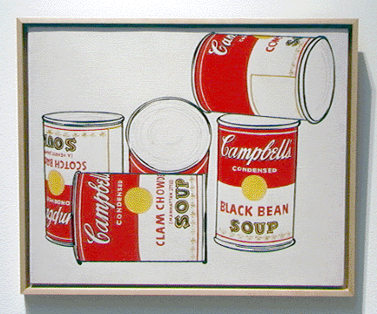
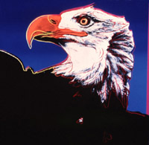
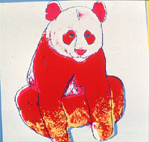
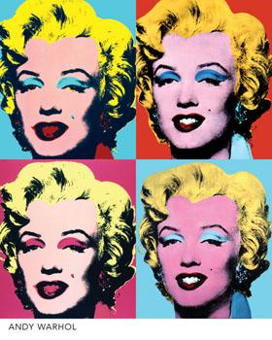
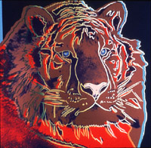
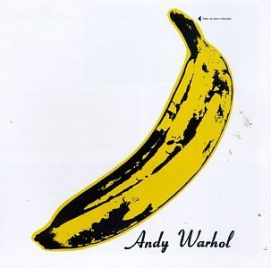
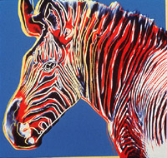
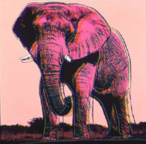
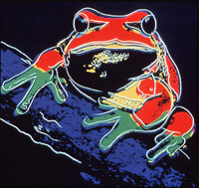
Andy Warhol Art
9

Slide 10
Art (as Poetry) as Argument
See link in Google Classroom!

Slide 11
Example: W.H. Auden’s “Unknown Citizen”
Born in England, but became a US citizen (wrote many of his greatest works in the US).
Themes: love, politics, citizenship, religion and morals, relationship between unique individual and the impersonal.
Wrote poetry, essays, reviews on literature, politics, and psychology, documentary films, plays, and other media.
“Unknown Citizen” published 1939, influenced by the Tomb of the Unknown Soldier (following WWI).

Slide 12
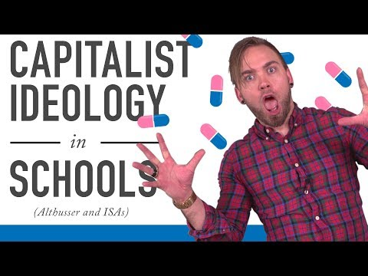
So what’s the critique?
Often, it’s political.

Slide 13
Political Criticism
Louis Althusser: leading Structuralist Marxist philosopher in France in 60s.
Thesis: “Ideology represents the imaginary relationship of individuals to their real conditions of existence.”
This is the idea that there are societal expectations, though not literally law, that people feel they must adhere to in order to be socially acceptable.
“I shall then suggest that ideology ‘acts’ or ‘functions’ in such a way that it ‘recruits’ subjects among the individuals (it recruits them all), or ‘transform’ the individuals into subjects (it transforms them all)...”

Slide 14
Political Criticism (continued)
Marxism: “One major assumption of Marxists is that culture, including literature, functions to reproduce the class structure of society. It does so by representing class differences in such a way that they seem legitimate and natural.”
“While some contemporary Marxist critics continue to emphasize the role of literature and of culture in reproducing class society, others look for ways in which literature undermines or subverts the dominant ideologies of the culture.”
“But literature also displays signs of contradictions (between classes, between ideologies and realities that threaten society from within and are put on display in literature.”

Slide 15
Rhetoric:
In visual Form

Slide 16
Remembering that Work TYPE Matters:
Type of Work | Work’s Function | Process for Publication | What to Judge
Academic/Professional Research Publication | Methodological study, informative, academic conclusions and perspectives to a specific, learned, and professional audience | rigorous review, multiple steps | Authorial prominence, mitigation of bias, objective standards, rigorous and replicable process, consideration of perspectives and limitations and applicable scope, ethical considerations
Journalistic Publication | Bias-free and objective information on a given event of issue for a public audience | Internal review, with consideration for journalistic integrity (ethics) | Authorial prominence, mitigation of bias, objective standards, knowledge of the issue, publisher reputation, ethical considerations, fair representation of perspectives
Public Speeches | Information and persuasion of public perception or a particular audience | Invitation, or process for public standing (reputation); internal review, or not | Speaker reputation, education, relevance on the issue; methods of persuasion, representation of perspectives; use of figurative language
Artistic Representation | Informative, persuasive, self-fulfilling, aesthetic, etc. | Multiple reviews, often multiple submissions to various publishers, at the publisher’s subjective discretion | Figurative language, reputation and education, connection to the events/issues; personal and public personality and ethicality; honest representation; aesthetic value; emotional appeal to audience, etc.

Slide 17
Art As Argument: ‘OPTIC’
[Paying attention to the details is a habit that is a necessary part of effective analysis. As you analyze visual texts (paintings, photographs, advertisements, maps, charts or graphs), the OPTIC strategy can help you construct meaning.]
O
Write a brief overview of the image. In one sentence, what is this image/work about?
P
List all the parts that seem important (for physical: things like color texture, groupings, shading, patterns, etc; for literary: things like structure, imagery, diction, figurative language, theme, etc.).
T
How does the title or text contribute to the meaning?
I
Explain the interrelationships in the artistic work: how do those individual parts connect, come together, work dynamically to create a mood, or convey an idea or an argument?
C
Write a conclusion that interprets the meaning of the artistic work as a whole?

Slide 18
Visual Rhetoric:
ART AS COUNTER-CULTURE
AND VIRALITY

Slide 19
STREET ART: A Modern Countercultural movement
Elements of street art to consider:
Anonymity
Short Life-Span (not meant to last)
An art expression that is “illegal”
Often commentary on “high brow” art - not dissimilar to pop art
Exit Through the Gift Shop:
7:00-14:30 = introduction to street art and Shepard Fairey
18:00-20:00 = inspiration behind Obey sticker
1:18:00-END = Banksy comparing MBW to Warhol

Slide 20
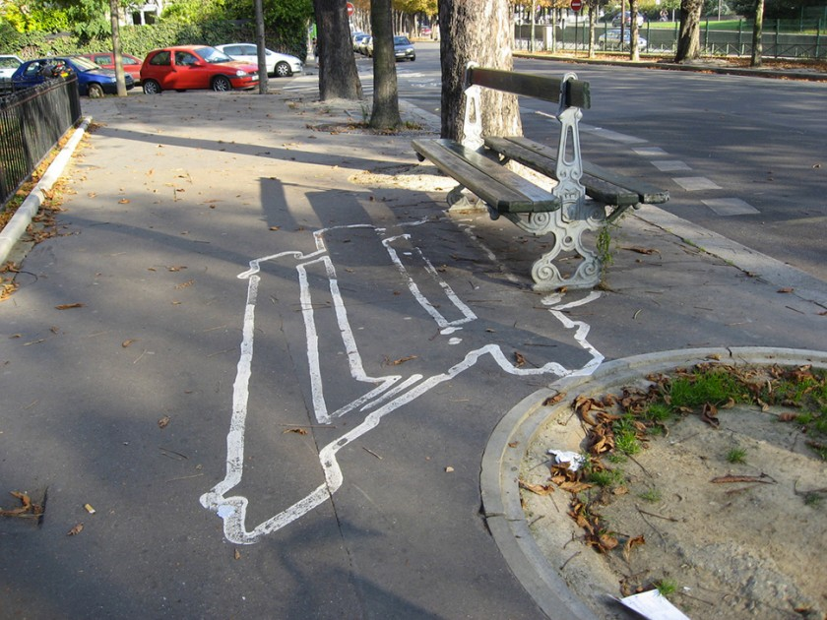
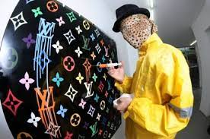
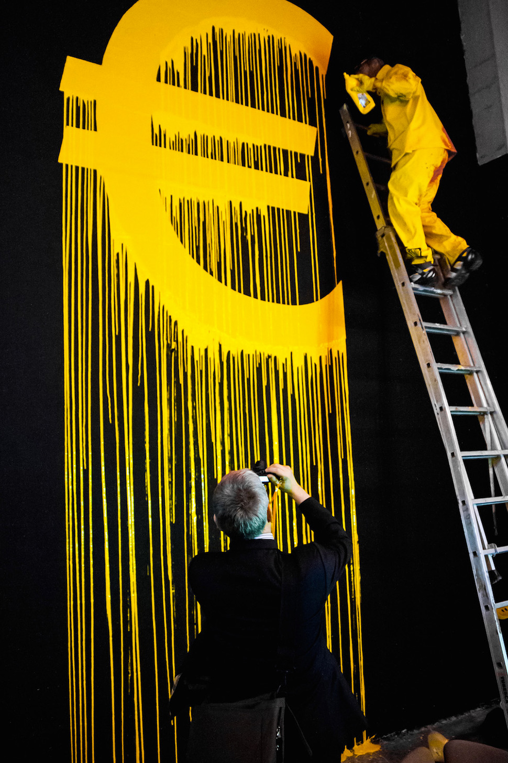
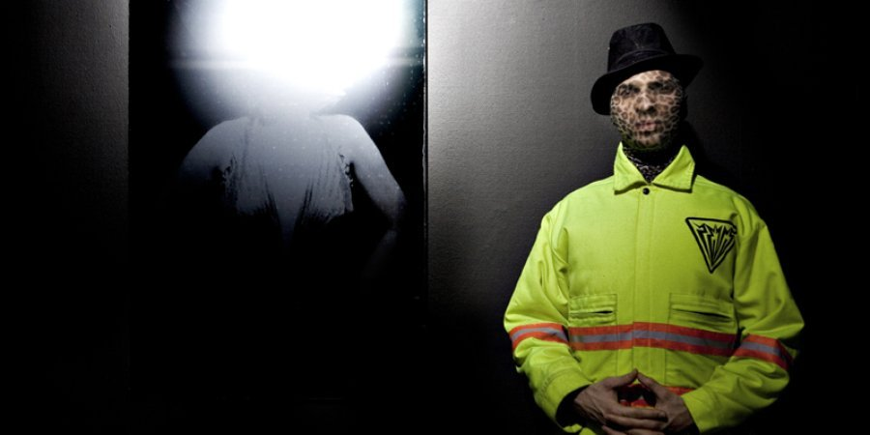
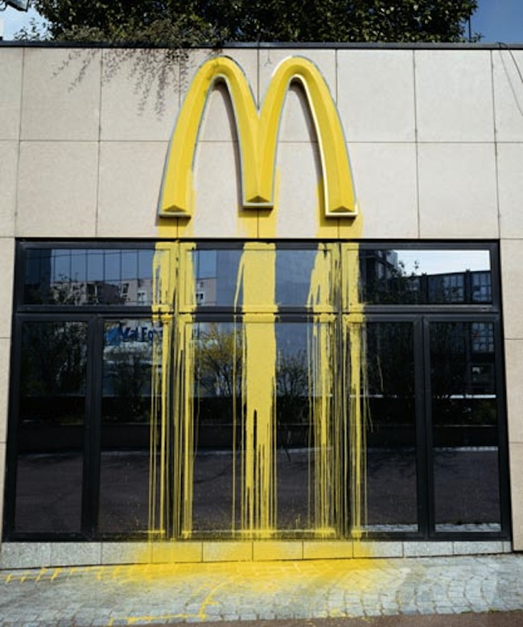
Zeus: Street Artist

Slide 21
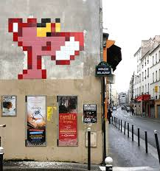
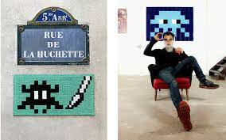
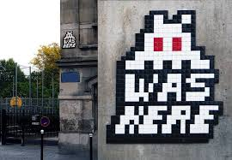
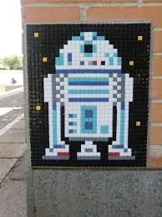
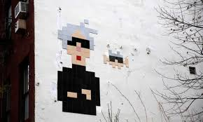
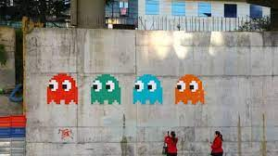
Space Invader

Slide 22
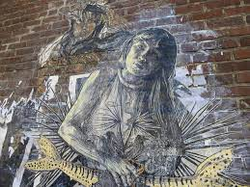
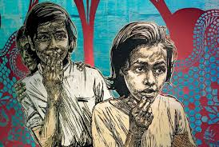
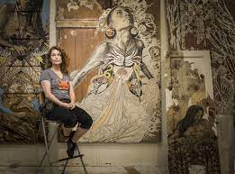
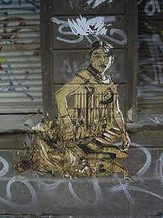
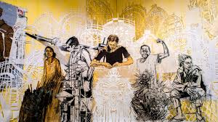
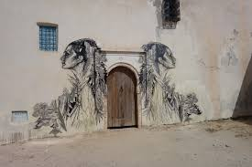
Swoon

Slide 23
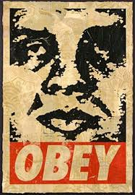
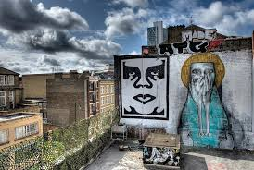
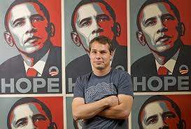
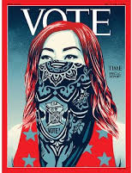
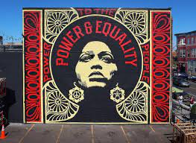
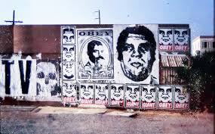
Shepard Fairey

Slide 24
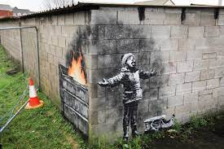
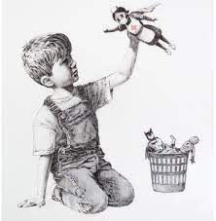
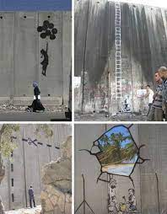
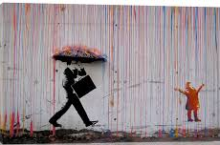
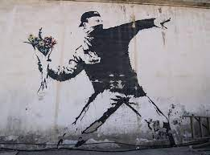
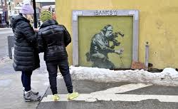
Banksy

Slide 25
Fairey: The Obama Hope Poster
2008 campaign poster from when Obama was a senator and was at an event with George Clooney (06)
Photographed by Mannie Garcia then altered by Shepard Fairey (also owner of OBEY fashion company)
He would later be sued for copyright infringement.
Compare to Warhol’s appropriation?

Slide 26
Why so Prolific?
It essentially went VIRAL (before going viral was as much of a thing as it is now…).
” ‘going viral’ is a common means of explaining how ideas, trends, objects, videos, and so forth spread quickly, uncontrollably, and unpredictably into, through, and across populations” (2).
“ ...viral phenomenon is made possible by first creating an image that is highly desired and admired, and second, by ensuring that a broad audience has access to that image so it can be redistributed” (2).
Still Life With Rhetoric - Laurie E. Gries

Slide 27
Constantly Reworked (through Today)
The image was quickly reworked for hope, parody, and satire.

Slide 28
Commodification
“Obama Hope’s transformation and circulation accelerated as its commodification became rampant and online news sources began reporting about the ‘Obamabilia craze’ that was sweeping the nation” (202).
“The eBayification’ of the Obama Hope image became especially popular when people who had gotten hold of Fairey’s original progress posters began selling them on eBay for prices as high as $1,000” (204). (Later shot up to over $4,000 once Hilary stepped out).

Slide 29
What does it mean?!
“As both an invention in photojournalism and an invention in political art, Obama Hope preceded its utility and its own possibility. First imagined to function as documentary photo and then as a political poster, Obama Hope exceeded these functions to take on a multiplicity of diverse rhetorical roles throughout its ongoing life: Protest, critique, satire, parody, advertising, fundraising, branding, education, commemoration, inspiration, entertainment, propaganda, commodification, embodiment, call to action, political enchantment, civic engagement, social and political commentary, environmental/political activism, rhetorical (dis)identification, and touchstone for debate” (281).

Slide 30
When Analyzing Art: Great THings to Consider
Who is the painter, what era of art did they belong to?
Classical painters depict scenes from the Bible, literature, or historical events (like the burning of Rome or the death of Socrates). Modernists, on the other hand, tend to subvert classical themes and offer a different approach to art. Modernism was born as a reaction to classical painting, therefore analyzing modernist art by the standards of classical art would not work.
What was the painter’s purpose?
Classical painters like Michelangelo were usually hired by the Vatican or by noble families. Michelangelo didn’t paint the Sistine Chapel just for fun; he was paid to do it.
Who is the audience? Artists like Andy Warhol tried to appeal to the masses. Others like Marcel Duchamp made art for art people, aiming to evolve the art form.
What is the historical context? Research your artist/painting thoroughly before you write. The points of analysis that can be applied to a Renaissance painter cannot be applied to a Surrealist painter. Surrealism is an artistic movement, and understanding its essence is the key to analyzing any surrealist painting.

Slide 31
Sample:
Analyze
some Art!

Slide 32
One more!
Check out the next module on structuring a written argument, using previous techniques to ensure own work is logical, credible, and effectively-supported.

