Slide 1
Recognizing Common Arguments, and Building your Own
In Three Common Structures

Slide 2
Argumentation, In Review
2
What is It?
An argument is an effort to justify a particular conclusion. The justification should be strong enough to persuade others that your conclusion is the correct one
Every argument consists of premises and a conclusion. The premises are particular statements that provide the reasons or evidence supporting your conclusion. The conclusion is, of course, the position that you are arguing for.
Types: Deductive, Inductive, Abductive, Analogy, and hybridized (two or more in complex conjunction).
Now we’ll look at how to construct more complex arguments beyond the literary analysis, five-paragraph essay. Generally, this requires different considerations, and often more open-minded recognition of potential failures of reasoning and evidence in a conscious and explicit way.

Slide 3
Constructing the Argument
3
The first step to creating an argument is to know what you are going to be arguing for. What thesis or conclusion will you defend? Often, you will need to research the differing positions on your subject before you can fully determine this.
The second step is to determine your premises, which comprise the reasons or evidence that support your conclusion.

Slide 4
Selecting Evidence
4
To support your position, you may rely on many different types of evidence including measurements, statistics, authority, reasoning, observation, and experience. It is helpful to consider the strengths and limits of the different types of evidence when choosing what to include.
Consider:
Which pieces of evidence are available?
What type of evidence is most appropriate for the assignment or course?
How do the different pieces of evidence support each other?
Which piece(s) of evidence best support(s) the conclusion?
What is the strongest evidence? The weakest?
In general, arguments rely on premises or evidence about what is known (or less controversial) in order to draw conclusions about the unknown (or more controversial). If your premises are debatable, you may need to support them with additional evidence.

Slide 5
Organizing Evidence
5
This comes in three common forms… But this is by no means an exhaustive list.
Toulmin Method, Rogerian Method, and Classical Method
The way that you organize your evidence determines the type of argument. For example, developing the logical connections between premises will produce a deductive argument, while relying on particular observations or measurements to infer conclusions will lead to an inductive argument. Arguments from analogy are constructed by determining the similarities between two comparable issues and showing that what is known about one is likely to be true for the other.

Slide 6
Note:
6
A few strong and well-developed arguments are stronger and more persuasive than many weaker and undeveloped ones.
Evidence does not speak for itself. It is crucial to explain how each piece of evidence supports your conclusion and what makes it credible.
The strongest points are most effective at the beginning and end of your argument.

Slide 7
#1: Toulmin Method
7
See resource handout.

Slide 8
Toulmin Basics
8
Structure
*building an argument through support
Claim
Data/grounds
Warrant (justification)
Backing (foundation/context)
Counter-argument
Rebuttal
Example
Hybrid cars help fight pollution.
For most private citizens, cars are most serious pollutant.
Switching to hybrid will impact individuals’ carbon footprint.
This can be shown by specific statistics (give).
However, one might argue that driving culture is the real problem.
And it may, but mass transit should also move to electric, and may not be entirely feasible in our culture around cars; may not be possible for suburban commuters.

Slide 9
When to Use the Toulmin Method?
9
Great for most argumentative situations; follows something of a scientific method, and generally based on strong research and evidence accumulation.

Slide 10
#2: Rogerian Method
10
See resource handout.

Slide 11
Rogerian Basics
11
Structure
*controversial topics
Introduction
Opposing view
Established validity
Own position
Contexts
Benefits of reformed view
Example
Issue of school uniforms.
Often supported by schools and parents, and maybe even some students.
Fosters inclusivity, removes the burden of trends and potential bullying based on looks, socio-economic status.
Mandatory uniforms are problematic.
Inclusivity is less the aim than conformity and compliance.
This stunts identity growth, which may bring the potential for bullying, but real benefits outweigh potential costs--instead, have dress code.

Slide 12
When to Use the Rogerian Method?
12
Rogerian is great for controversial topics in which the researcher is looking for common ground between two extremes, or if the argument is supporting a generally less widely-accepted view, or a newer interpretation of a well-known problem.

Slide 13
#3: Classical Method
13
See resource handout.

Slide 14
Classical Basics
14
Structure
*definition and application
Introduction
Background/current scholarship
Claim/proposed view
Argumentation and evidence
Refutations
Conclusions
Example
Minimum wage discussion, too many viewpoints on how much to pay
Currently, too many workers unable to secure basic necessities without a living wage
Raise federal minimum wage
80.4 million Americans work for an hourly wage, but nearly 1.3 million receive wages less than the federal minimum (raising federal will help encourage state increases)
Cost of living and inflation problems, even if raising wage
Worth it for mental health and well-being; no decrease in productivity

Slide 15
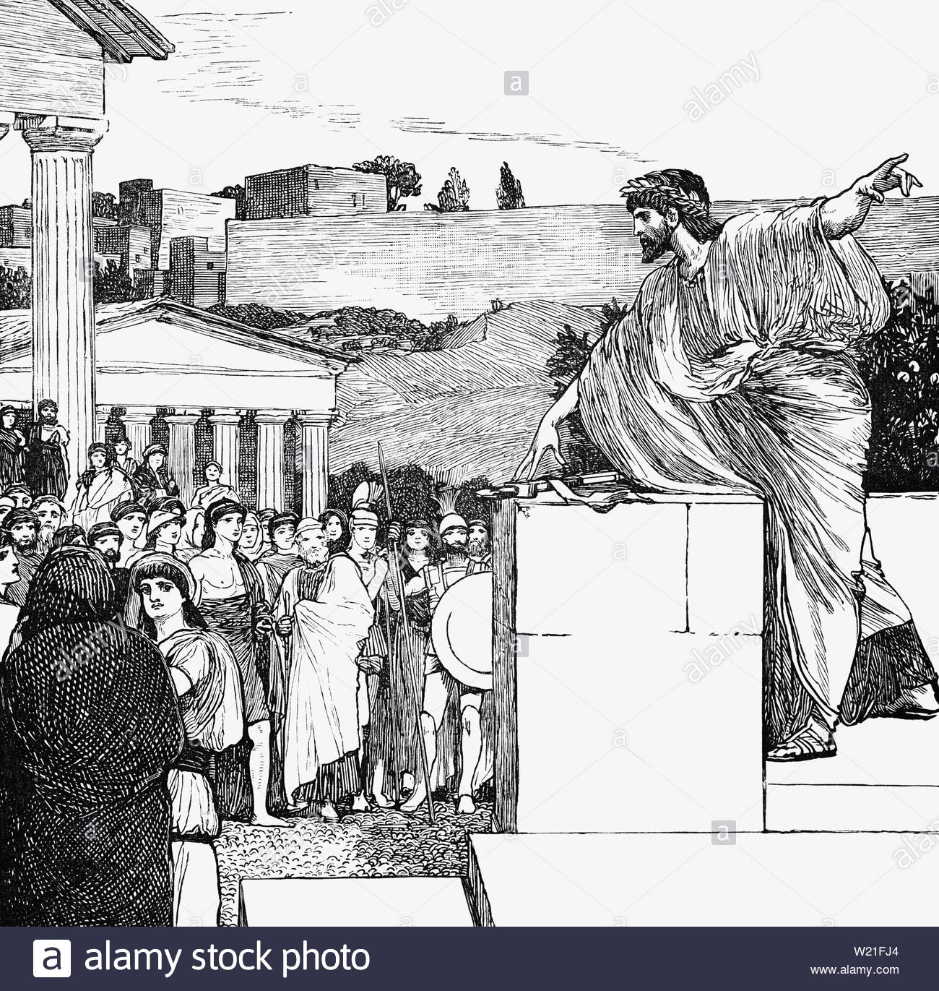
When to Use the Classical Method?
15
Also applies across subjects and types, but is best for more theoretical, analytic work where definitions of terms and narrowing concepts or scope is a big part of the equation (think issues of interpretation, qualitative work based on perspectives, analysis of art, philosophy, etc.).

Slide 16
The major difference in these new practices? Acknowledging the Counter-arguments.
16

Slide 17
Addressing Counter Arguments
17
An argument that is entirely one-sided will not be persuasive. In order to successfully convince someone that your claim is correct, you need to be able to anticipate objections and develop responses to them. This requires awareness of the evidence and reasons that contradict your conclusion, and the ability to find the flaws in them.
ASK:
Who might disagree with my position? Why?
What gaps or omissions are there in my evidence (or reasoning)?
What evidence would support an opposing position?

Slide 18
Important!
18
Always treat opposing positions respectfully and fairly. This will make your own argument much stronger because it (a) forces you to attend to the very precise reasons why someone might hold another point of view, and (b) leads you to think more carefully about why you disagree.

Slide 19
Three Considerations for Critical Reading
19
Identify
Analyze
Evaluate

Slide 20
Final Return to the Original Big Tech Article
20
Do that final evaluation; ask yourselves the questions:
Is this argument logical (it is, so next step); is the evidence provided strong enough to support the claims? Do you have your own knowledge that could further support, or deny, her claims?
Does she do her due diligence in addressing counter arguments? Are her refutations strong enough?
Who is this author? Research her. Does her authority carry weight in this argument?
Who is her intended audience? Use contextual clues--is her argument persuasive for that audience?
Are her rhetorical strategies (ethos/pathos/logos) clear? Strong? Sincere (and not deceptive)?

Slide 21
This concludes our seminar modules! Thank You!

